Slide 1






AICTE Productization Fellowship
YUKTI Innovation Challenge 2025
Institution’s Innovation Council (IIC), AICTE
2nd Stage Evaluation
Proto ID:IR2025-942972
IIC Institute Name: Vardhaman College of Engineering
Team Lead Name: P Venkata Teja
Theme/Sector of Focus: Healthcare & Biomedical devices
Mentor Name: Mr. Tareeq Zaid
Team Members: H Uday Kumar
P Bhargavi
P Pranitha
Innovation Title: MindEase - Your Mental Wellness Companion

Slide 2
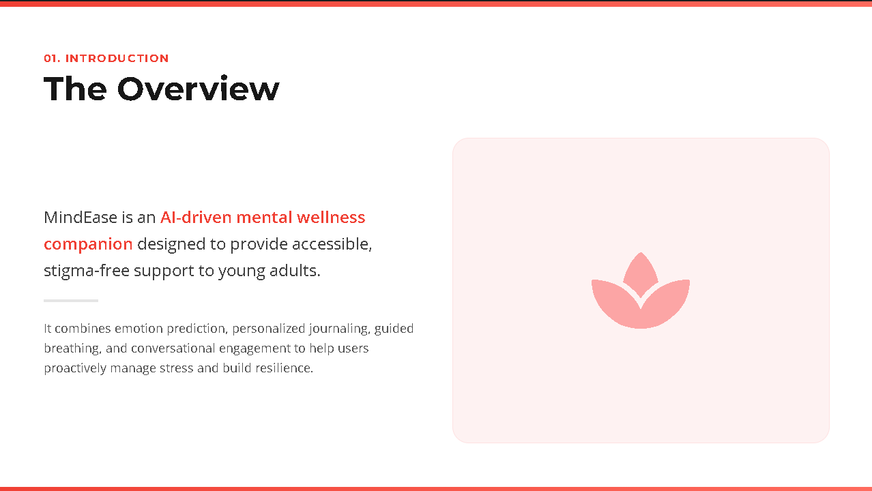
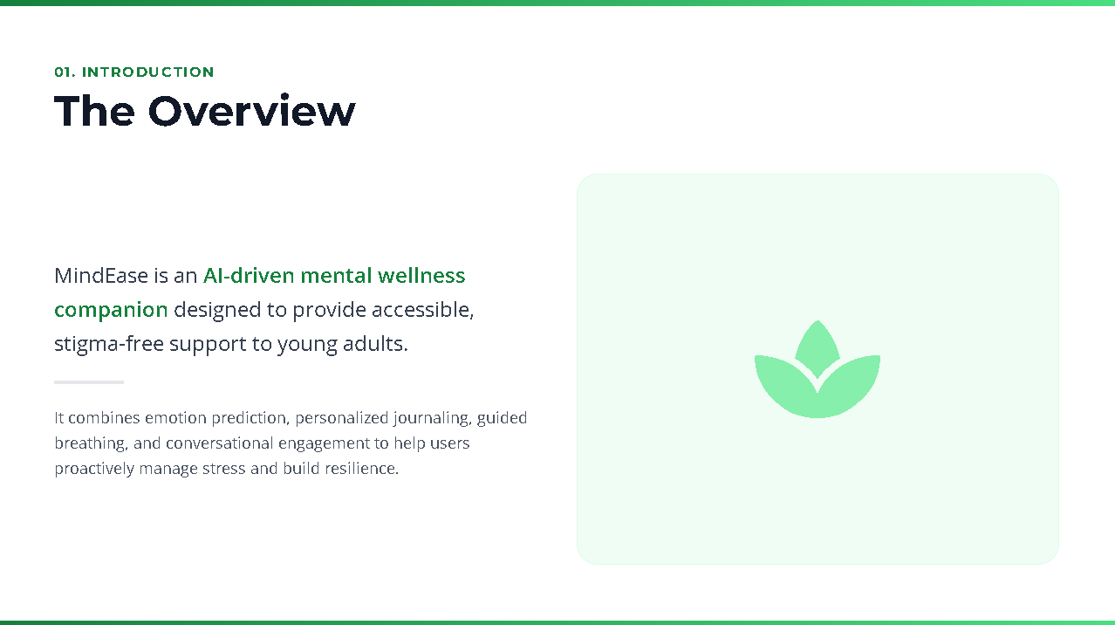
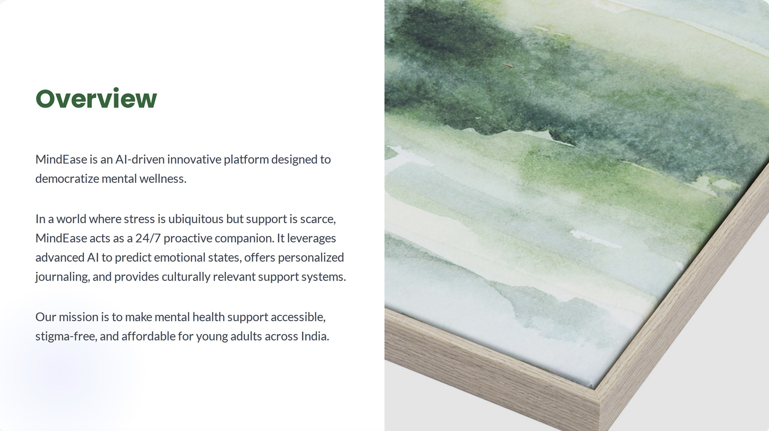
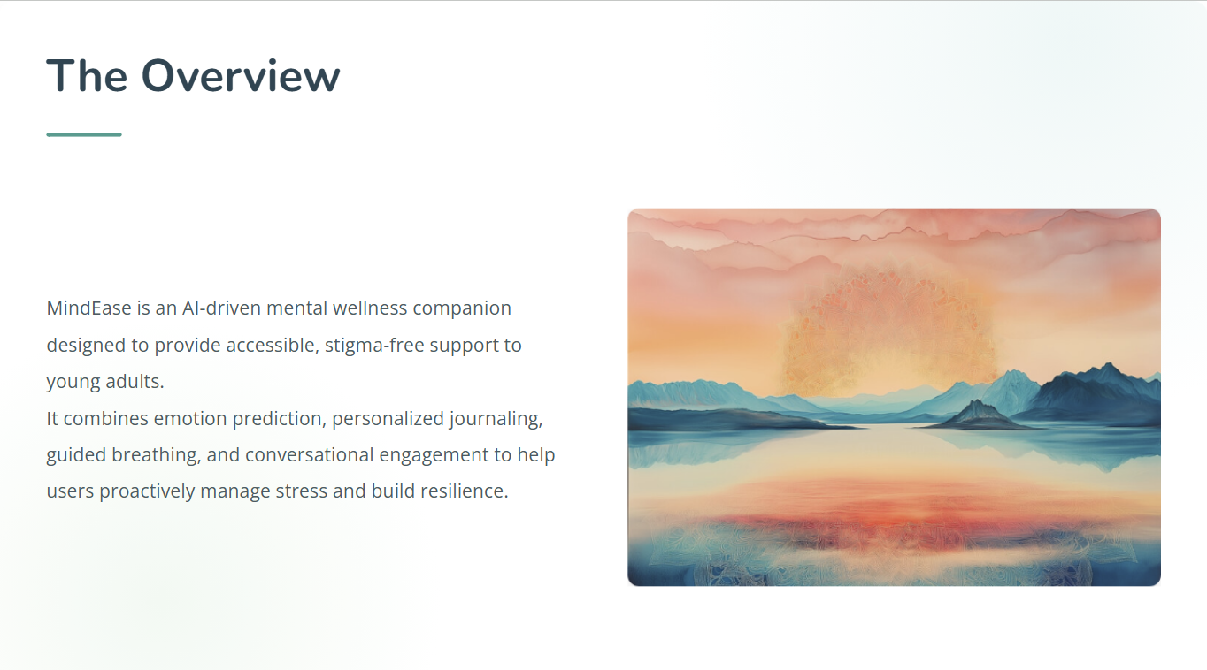
1. The Overview
Create a very high-level overview of your product or service
To empower students and professionals to manage stress before it becomes overwhelming - using technology that listens, understands and supports.
The Overview
LEARN NOW

Slide 3
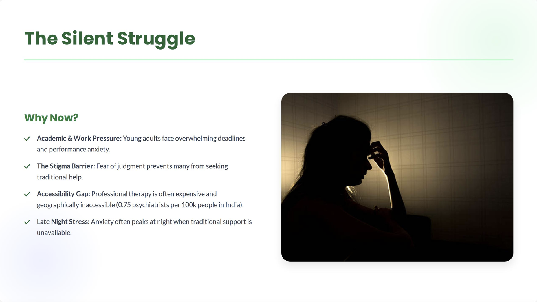
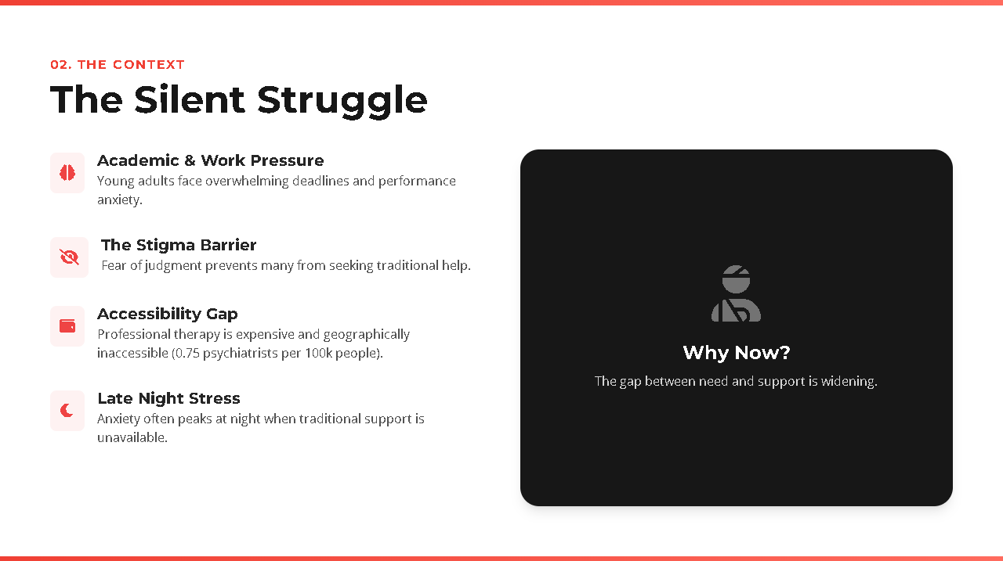
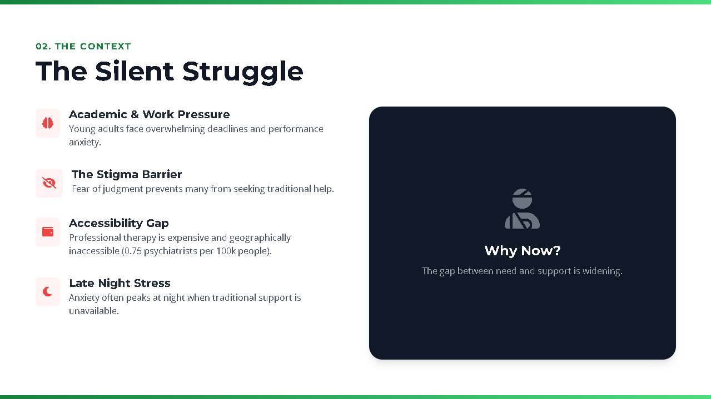
2. The Problem
What problem are you trying to solve? Is it really a problem?
Many students and professionals experience chronic stress, anxiety, and emotional fatigue but hesitate to seek help due to stigma or lack of access.
Tech individuals aged between 18-30 who want private, intuitive tools to manage emotions and stay balanced while juggling studies or work.
MindEase predicts stress and offers personalized support via an AI chatbot, journaling, breathing tools - built with React, Express and Gemini API
LEARN NOW

Slide 4
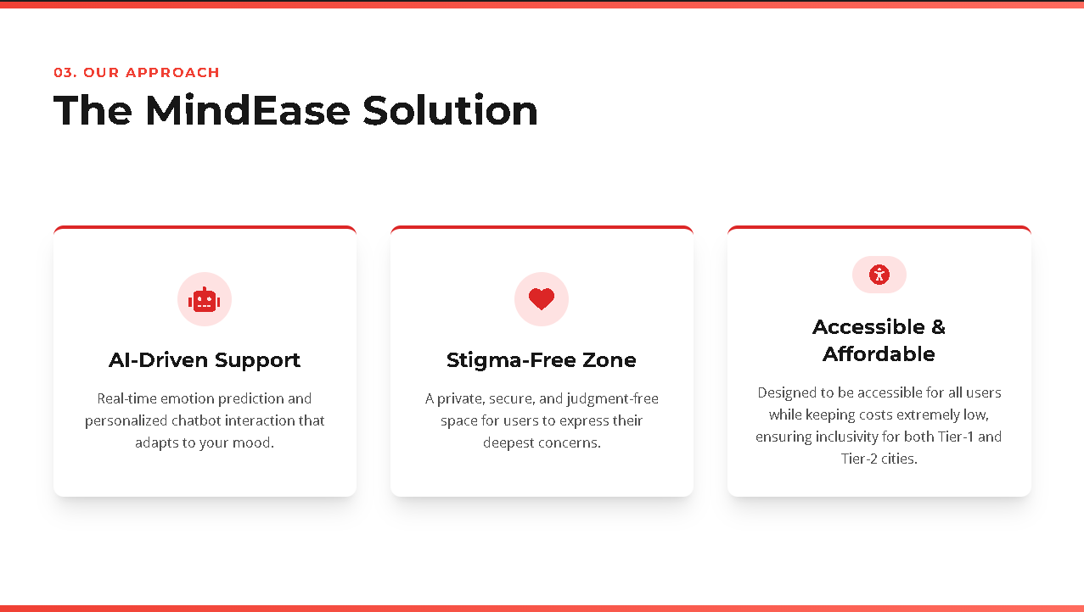
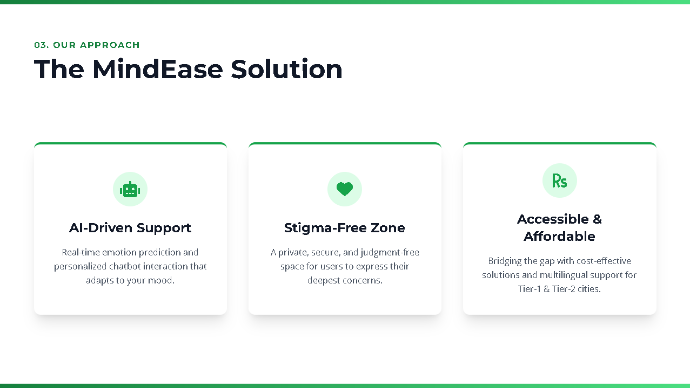
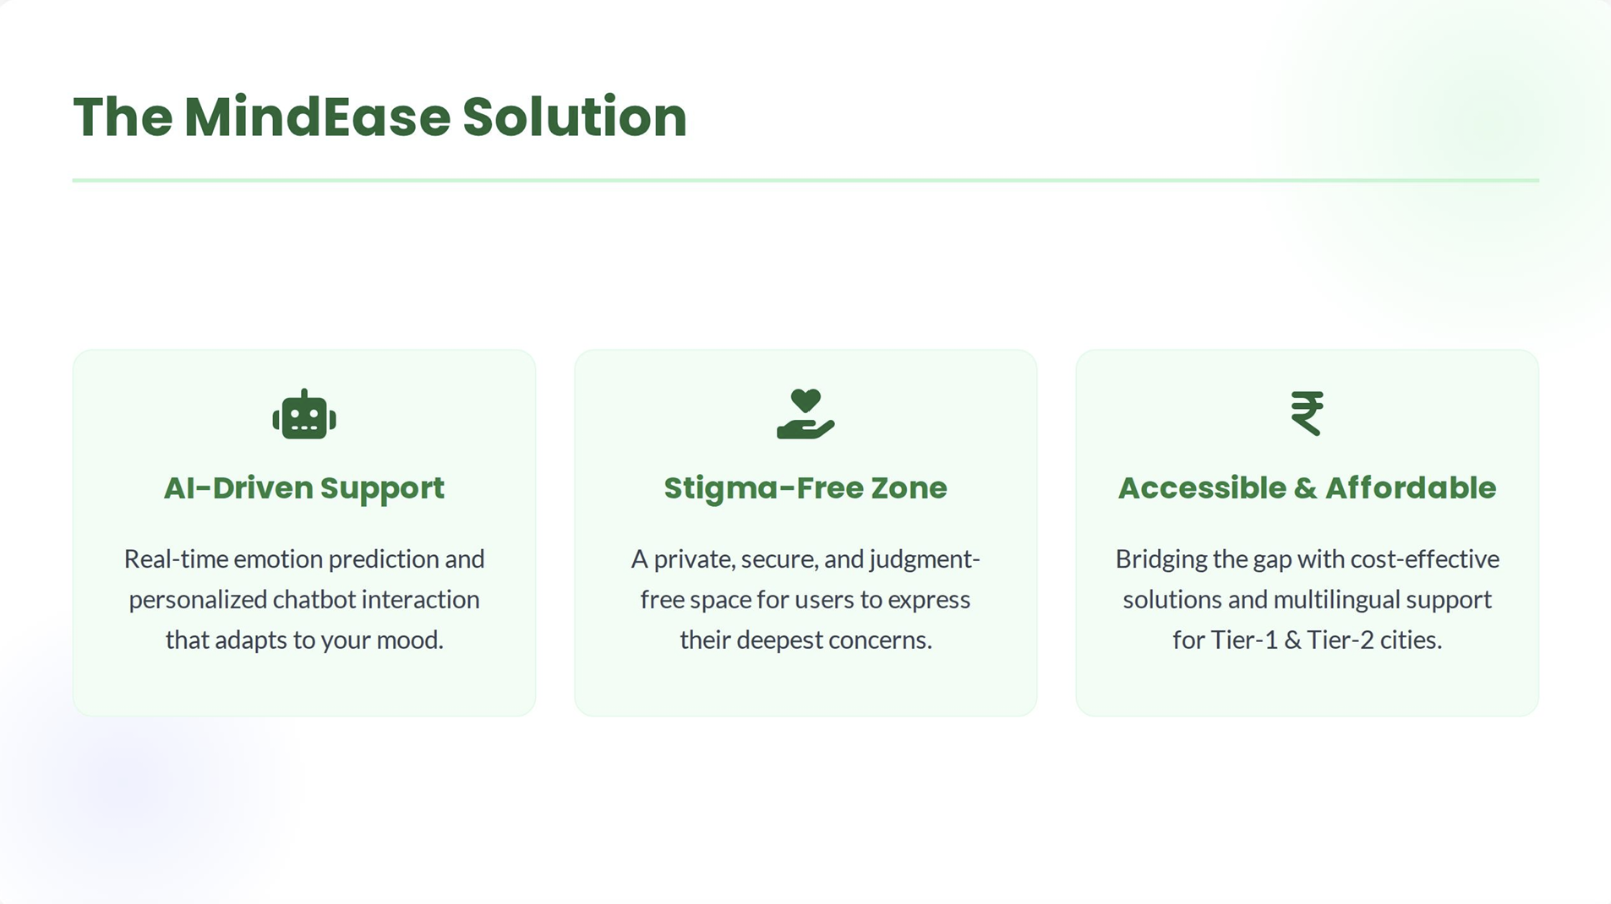
3.The Solution
Describe how are you solving the problem
MindEase is an AI-powered mental wellness companion that predicts emotional stress and offers personalized support that chat, journaling and breathing tools.
It’s proactive, private and stigma free - designed for younger users who want intuitive emotional support without clinical barriers.
MindWase ensures strict data privacy and security, complyiny with global standards to protect user information and build lasting trust in digital mental wellness.
LEARN NOW

Slide 5
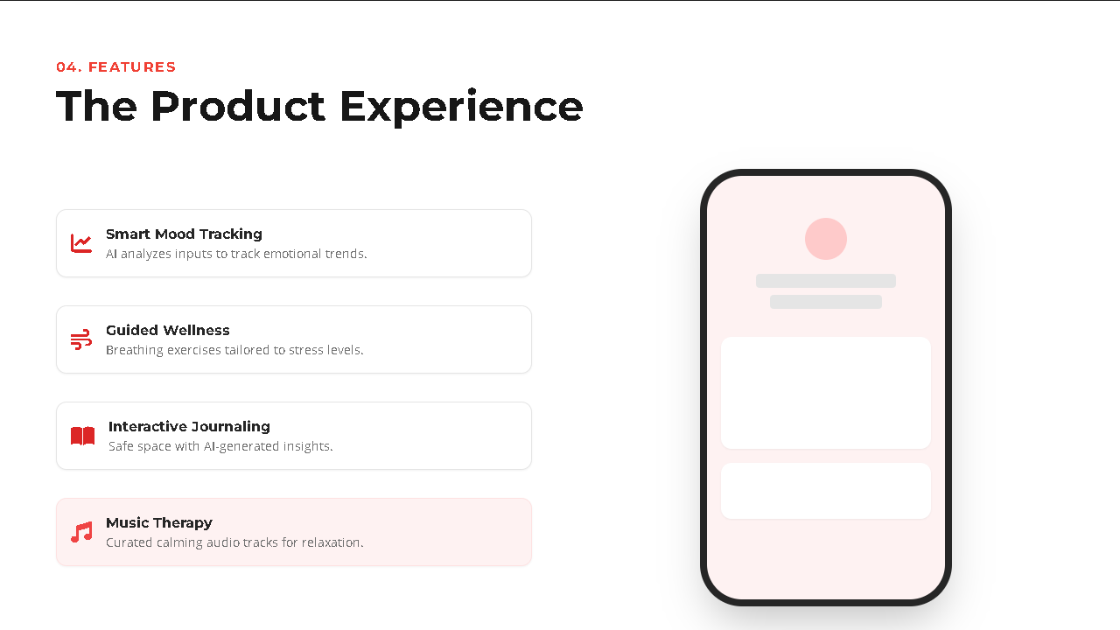
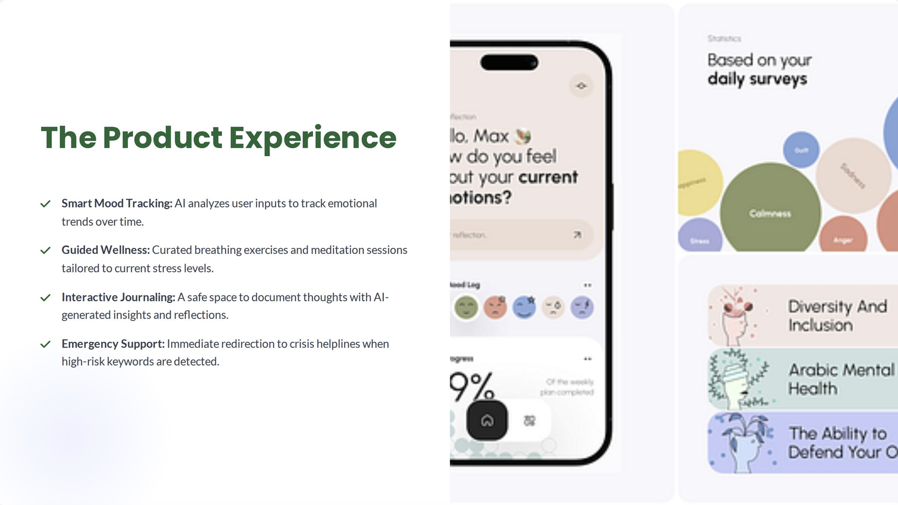
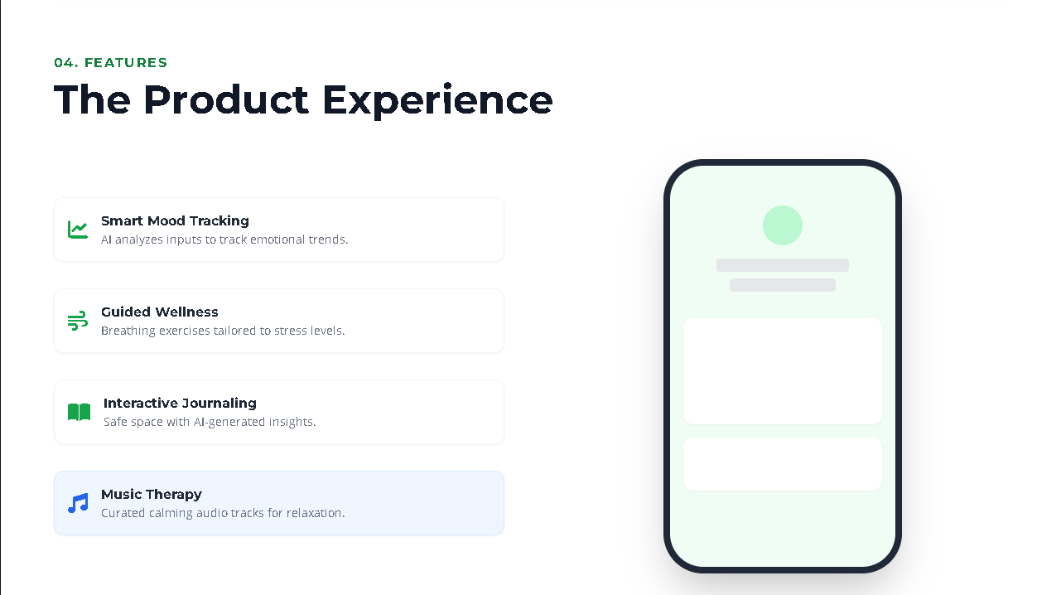
4. The Product/Service
Describe how are you solving the problem
MindEase goes further by tracking progress over time, offering users actionable insights into their emotional patterns and helping them build resilience through consistent, personalized self-care routines
MindEase is an AI-powered mental wellness platform that predicts stress levels and offers personalized support through calming chatbot, journaling prompts, breathing exercises and progress tracking.
This stands out by combining emotional intelligence with personalization. It’s designed for young users who want mental clarity without clinical complexity.
LEARN NOW

Slide 6
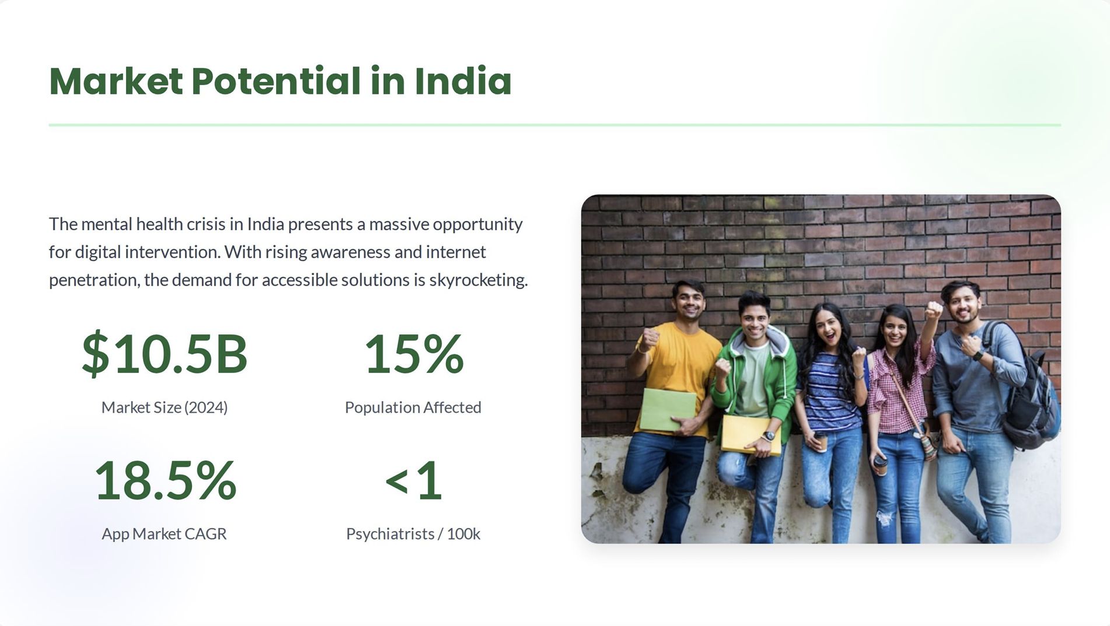
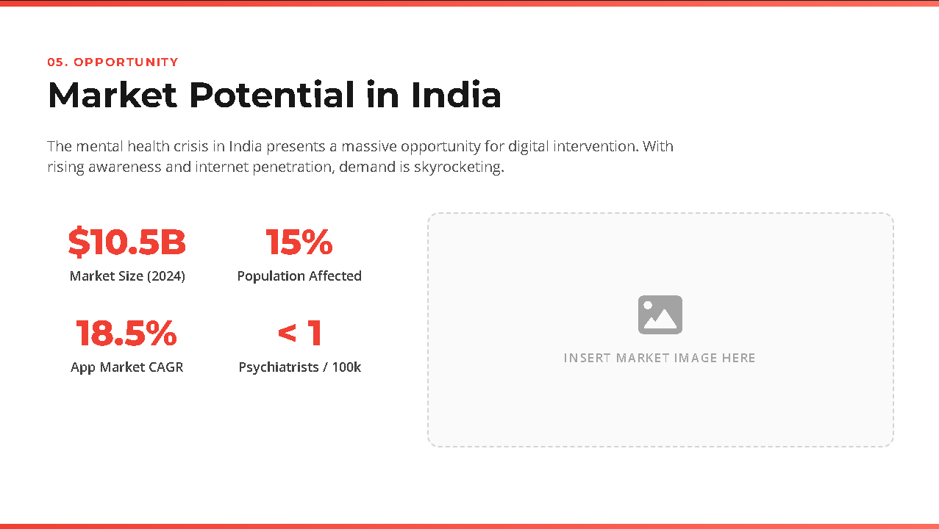
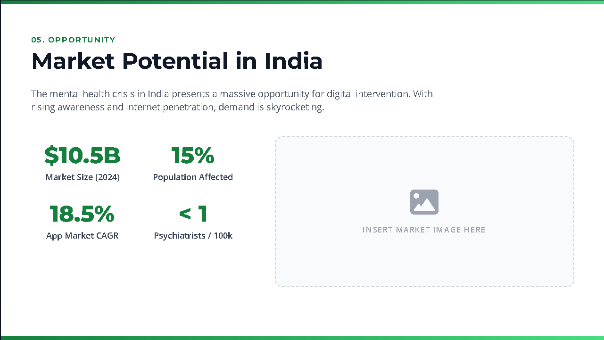

5. Market & Opportunity
Describe/Highlight the size of your target market
The global mental wellness app market including all individuals seeking emotional support, stress relief and self care tools. This includes students, working professionals and individuals.
Young adults in India aged 18 - 30 with access to smartphones and internet, who are open to using digital tools for mental wellness. This segment is reachable through app stores, college outreach.
College students and early career professionals in Tier1 and Tier2 cities who experience academic or workplace stress but hesitate to seek traditional therapy group values privacy, convenience and emotional clarity.
LEARN NOW

Slide 7
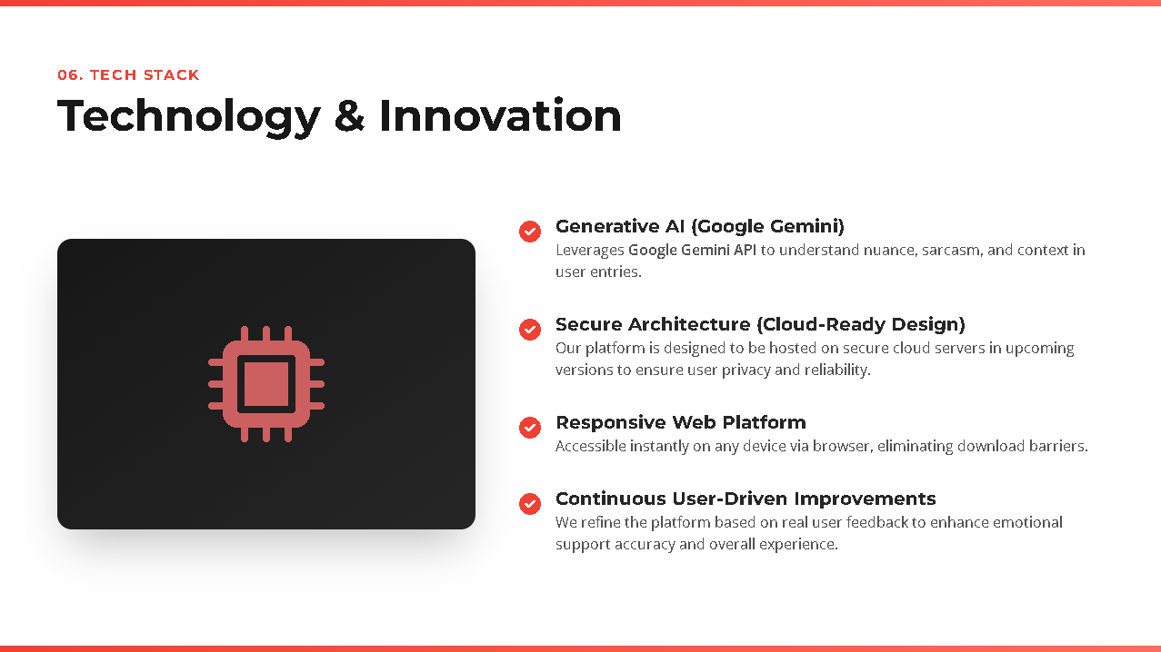
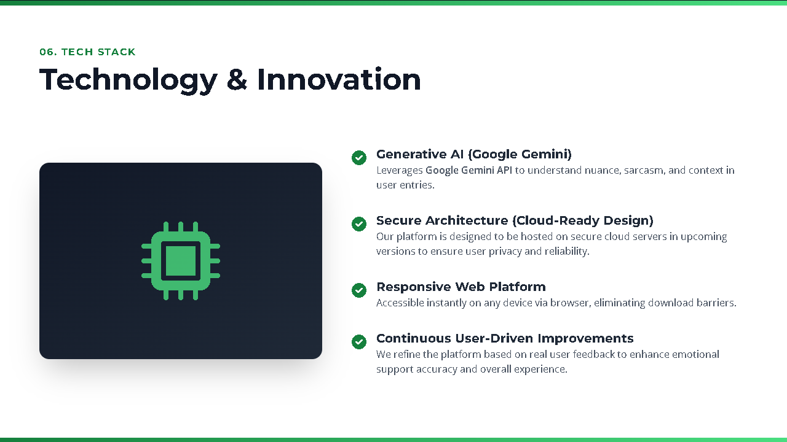

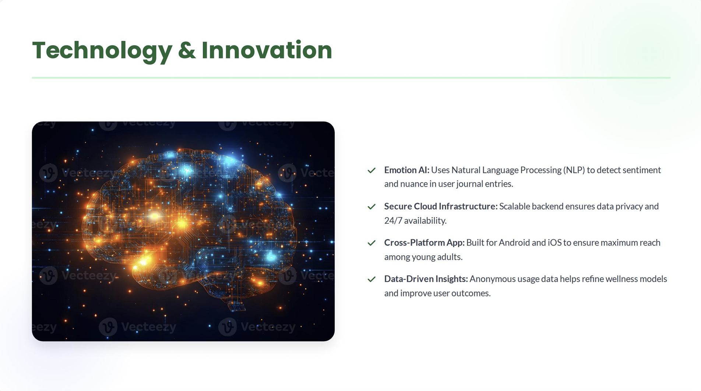
6. The Technology/Innovation
Describe the technologies you are using to solve the problem
MindEase is currently at TRL 5-6, with a validated prototype and early user testing underway. Core features like emotion prediction, journaling and chatbot suppofg are functional.
Short Term: Expand beta testing across universities. Mid Term: Launch on app stores, initiate parterships with mental health NGO’s and begin menotization through premium features. Lomg Term: Scale nationally, introduce AI-powered peer support groups and explore international expansioin.
This leverages a unique blend of sentiment analysis and behavioral pattern recognition tailored for Indian youth. The innovation lies in its emotion aware journaling engine and adaptive chatbot.
LEARN NOW

Slide 8
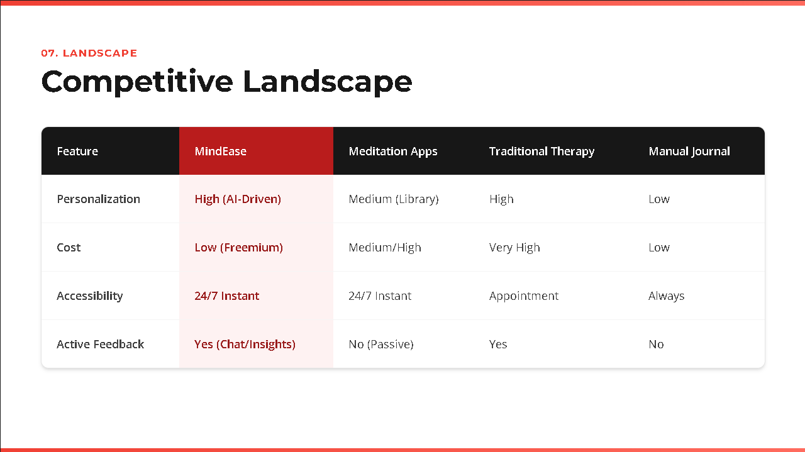
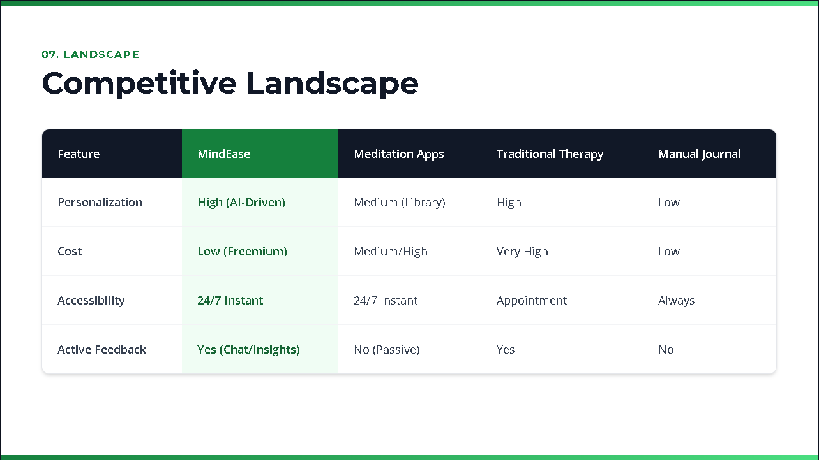
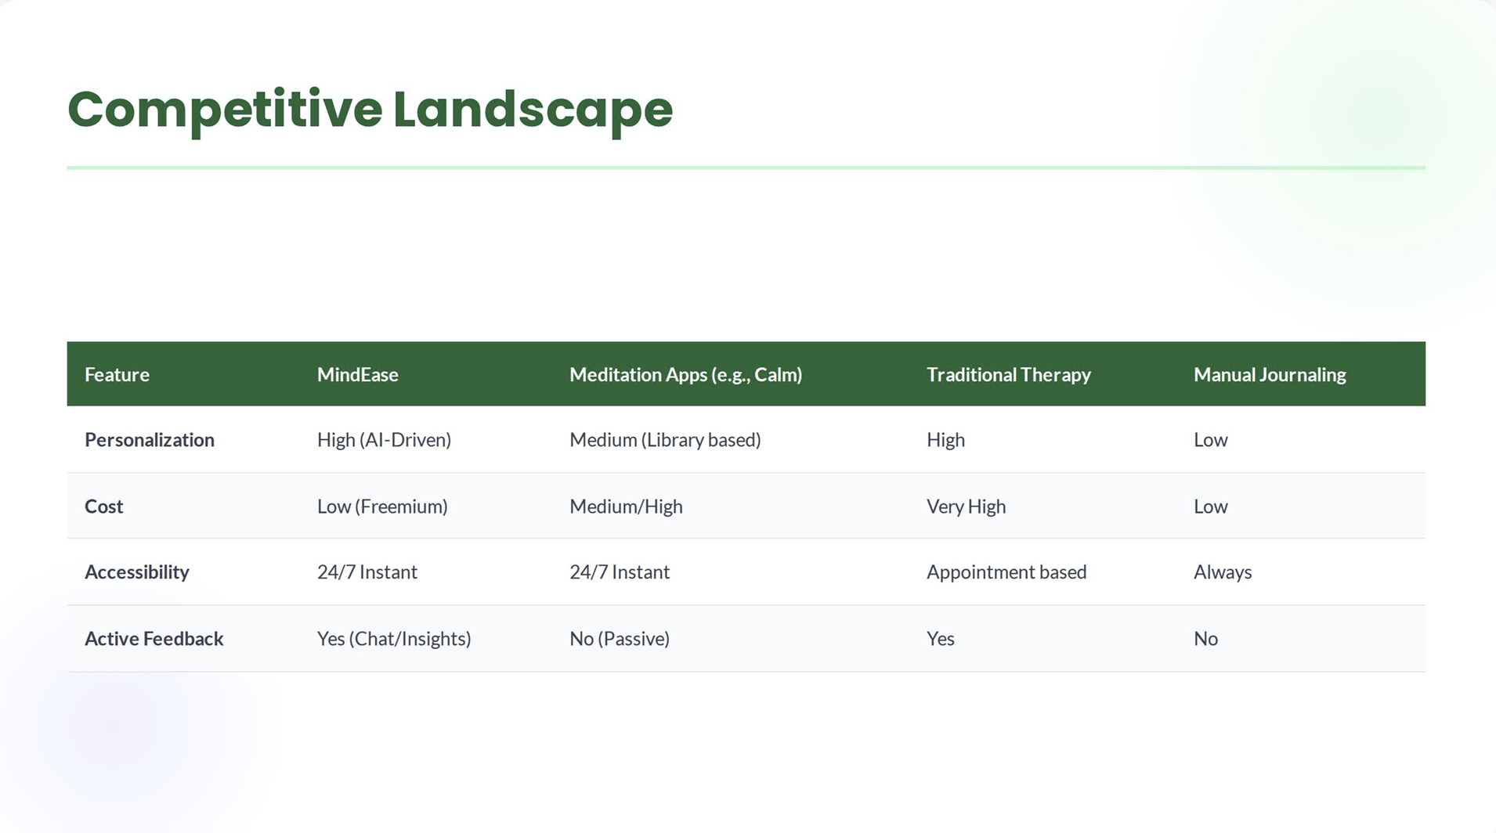
7. Competitive Landscape
What are the alternative solutions available in the market?
MindEase competes with platforms like Headspace and MindPeers which offer wellness tools such as chatbots, meditation and journaling.
MindEase is stigma free, culturally sensitive and built for students and professionals who prefer conversational, intuitive tool over clinical interfaces
MindEase is protected by its unique emotion prediction tech and aerlt university partnerships, making it hard to replicate. It also has strong collaboration potential with NGOs, counsellors and academic platforms to expand reach and co-create impactful features.
LEARN NOW

Slide 9
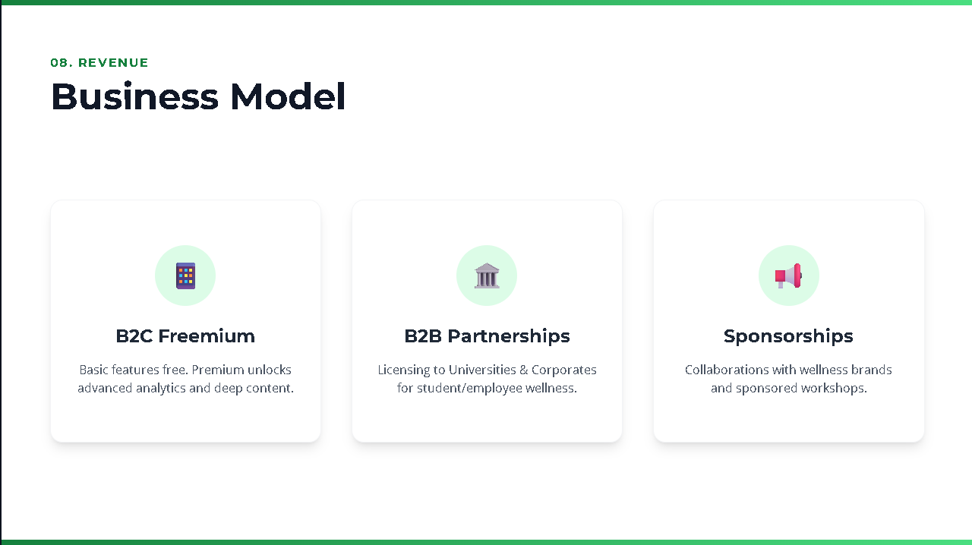
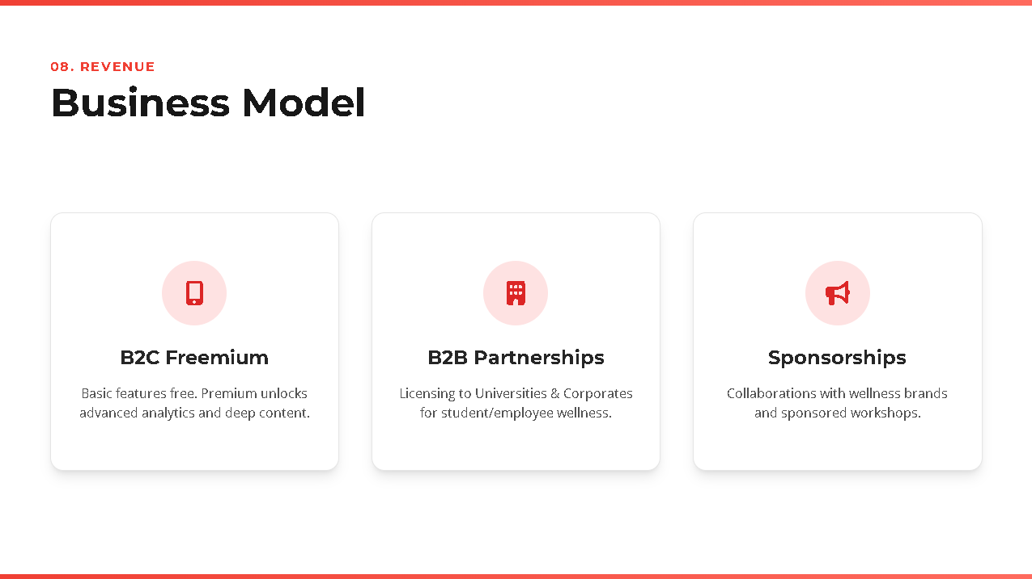
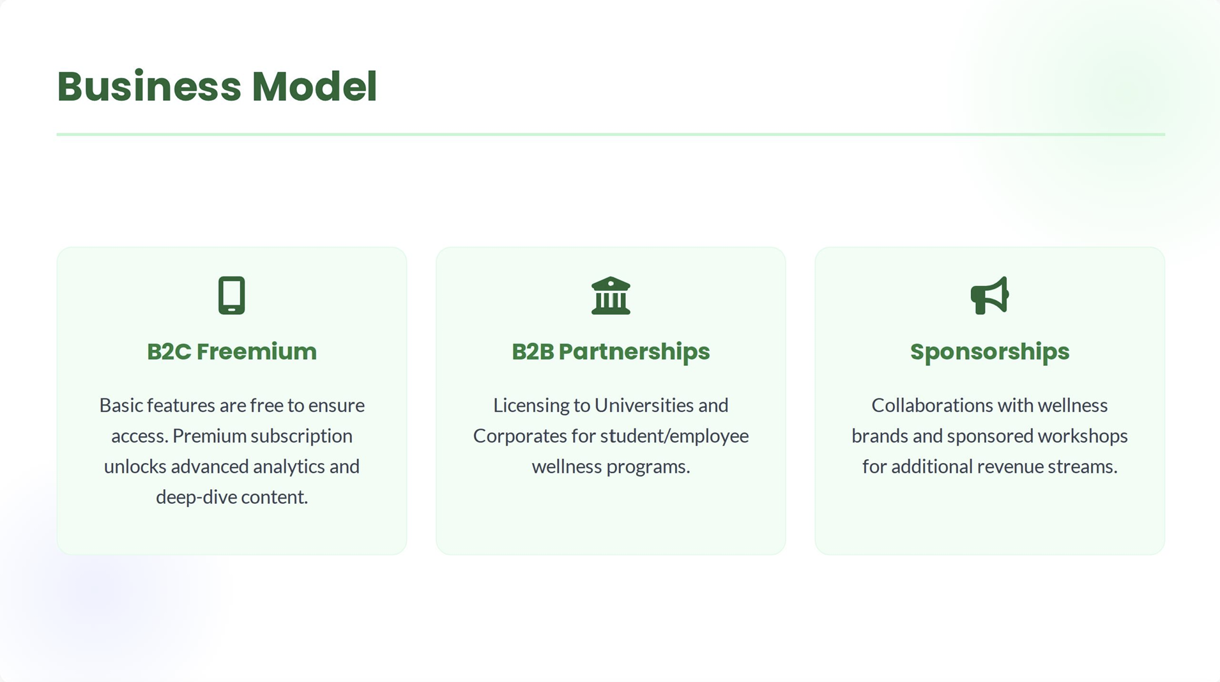
8. Business Model
What is your revenue model?
MindEase will generate revenue through a freemium model-offering core mental wellness features for free and premium features like advanced emotion tracking, personalizes coaching and AI-powered journaling insights via subscription.
Even if not yet profitable, MindEase has a scalable model with strond demand students and professionals. Its personalizes, stigma free approach fills a critical gap in mental health support, making it attractive to both uers and investors
LEARN NOW

Slide 10
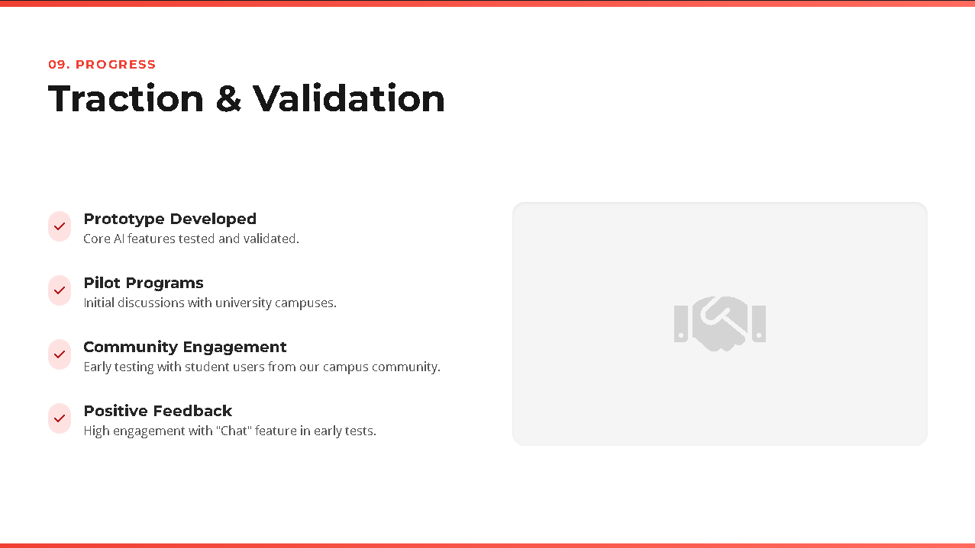

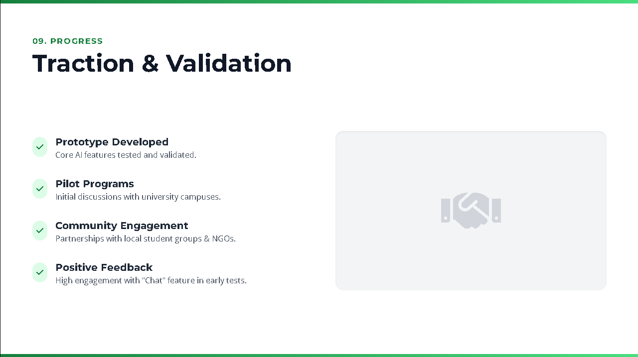
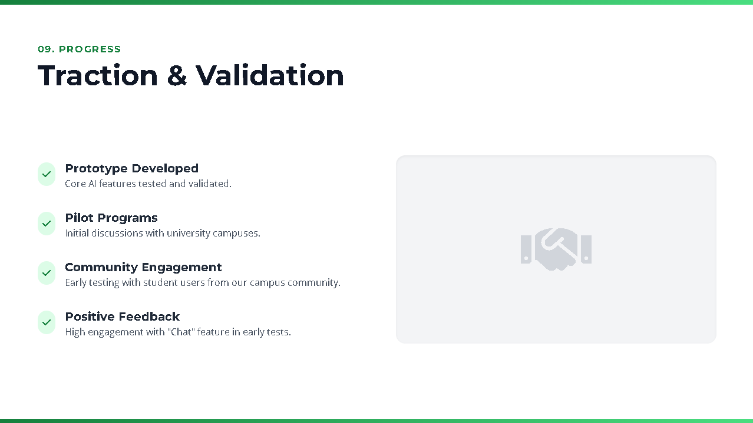
9 Traction
Customer Validation
Early Adoption & Engagement MindEase has attracted beta sign-ups from students and professionals, with strong engagement across journaling, breathing and chatbot features. Users show repeat usage and emotional tracking behaviour, indicating product-market fit and habit formation
MindEase is currently in its developing stage, where month-on-month user growth is beginning to emerge. Early traction is visible through letters of intentfor pilot deployment. At this stage, KPIs focus on beta funnel metrics, features engagement rates and institutional outreach. These signals demonstrate promising early adoption and lay the groundwork for scalable partnerships and future revenue streams.
LEARN NOW

Slide 11
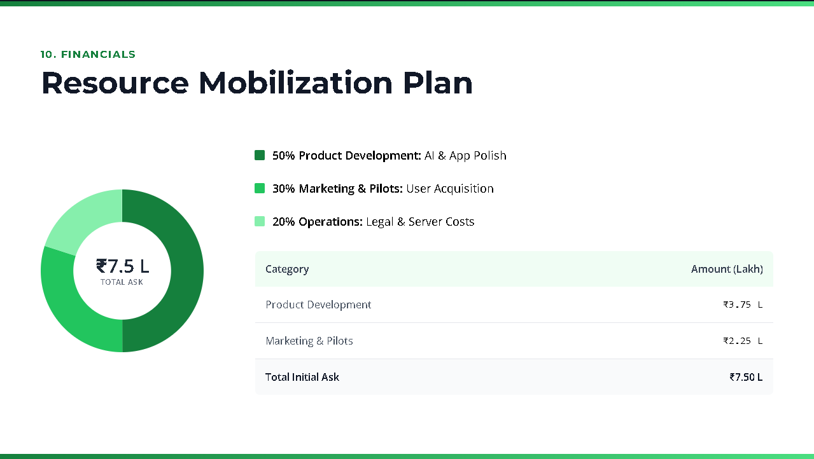
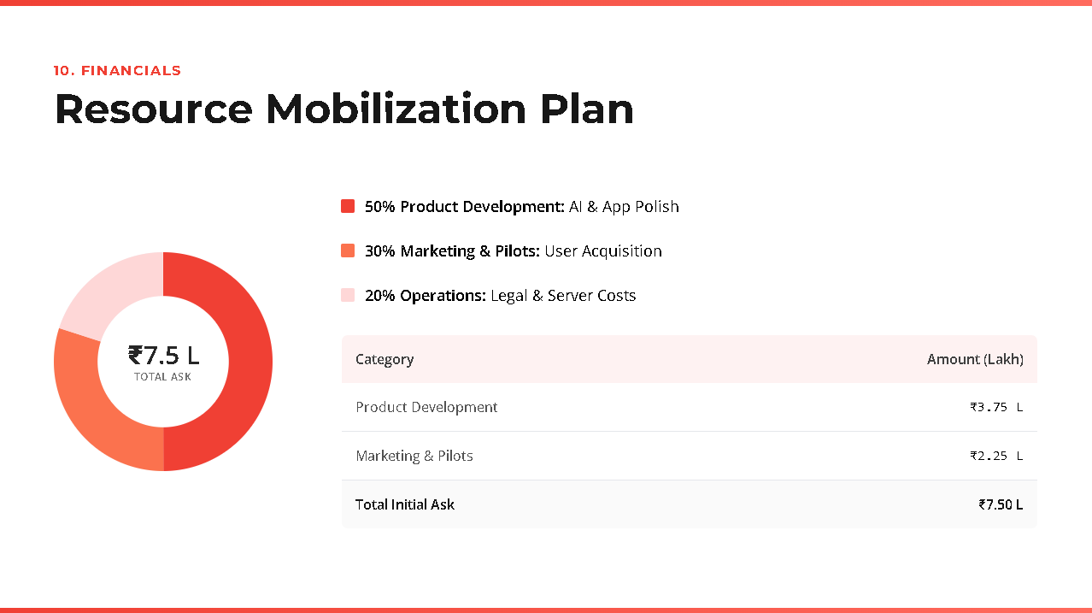
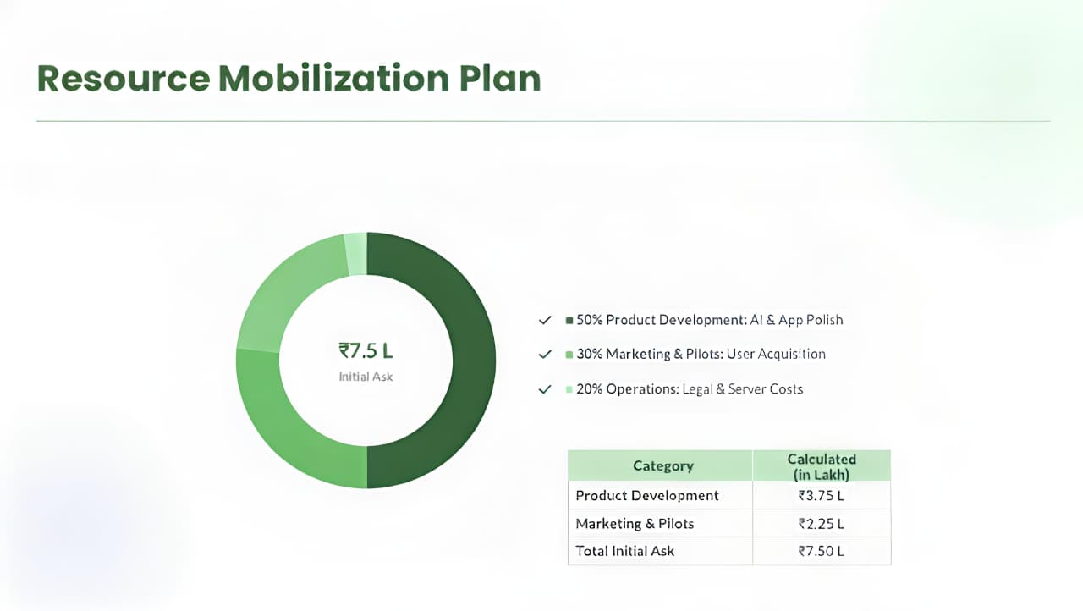
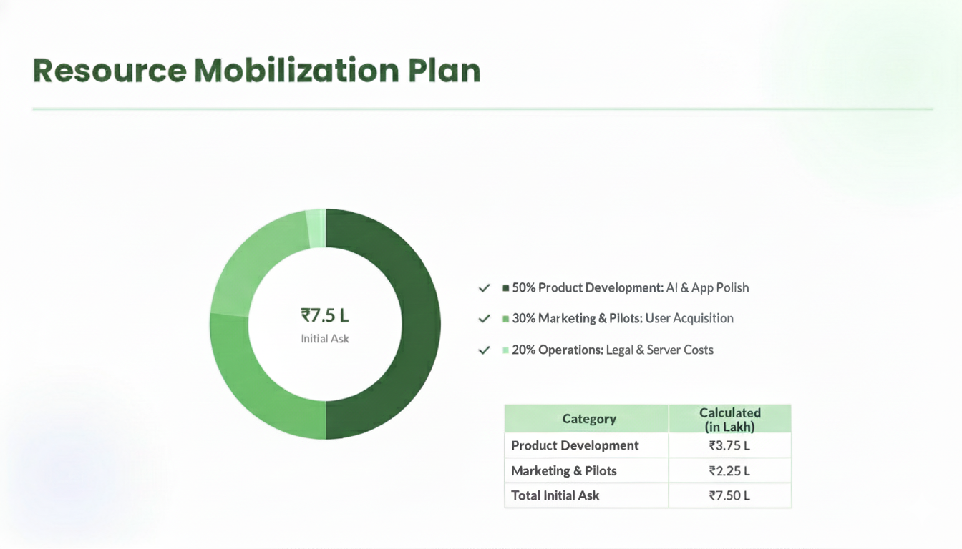
10. Resource Mobilisation Plan
What is your Resource Mobilization Strategy and What you have done so far?
MindEase is currently in the beta phase with core features developed and tested. The next milestone is scaling deployment across campuses and refining user experience based on feedback,
MindEase is currently in its developing stage with support from friends. We now seek strategic funding to grow the team, refine features and scale across campuses and partners.
We need a small cross functional team: 2 full-stack developers, 1 AI engineer, 1 UX designer and 1 mental health advisor.
LEARN NOW

Slide 12
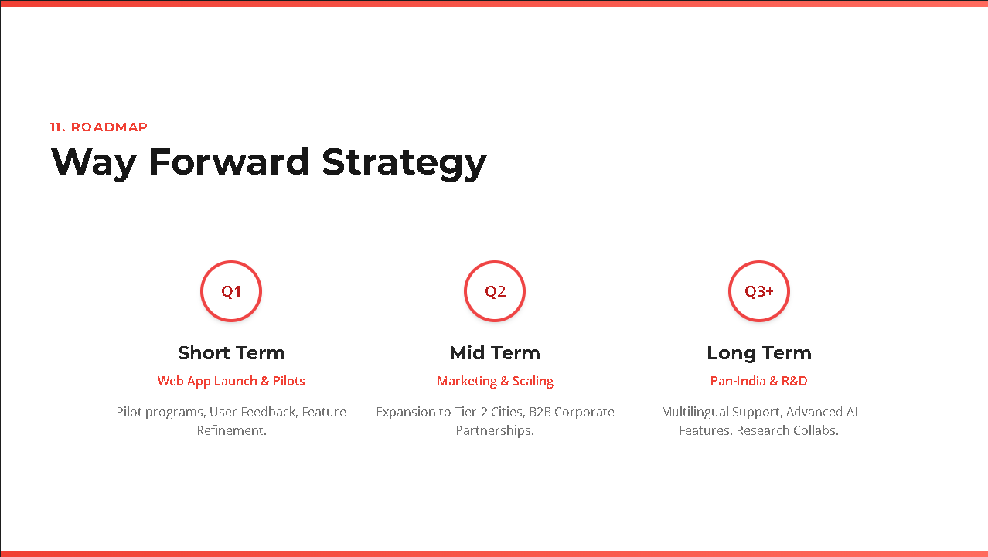
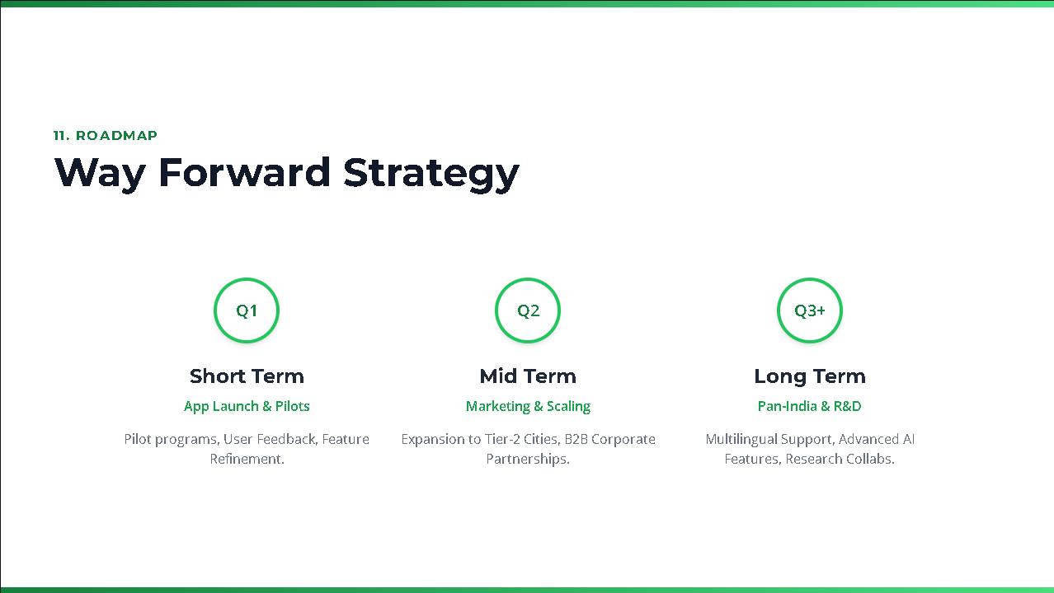
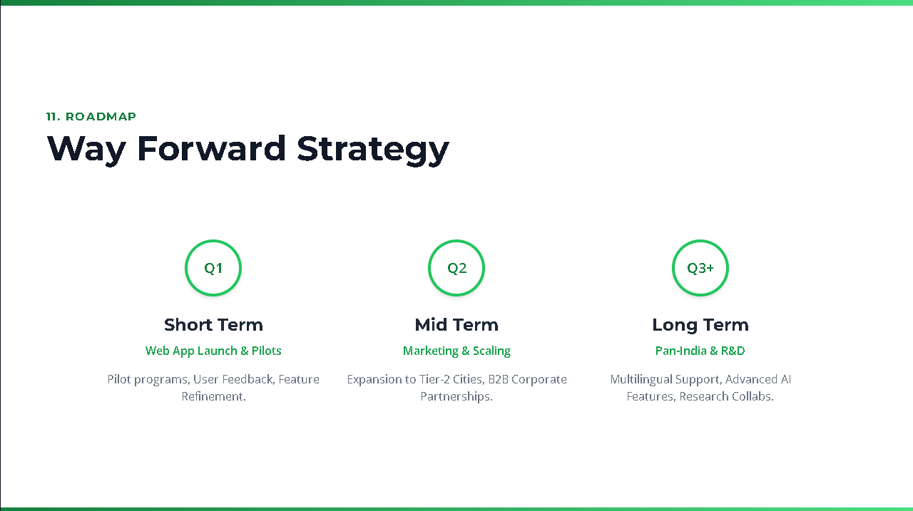
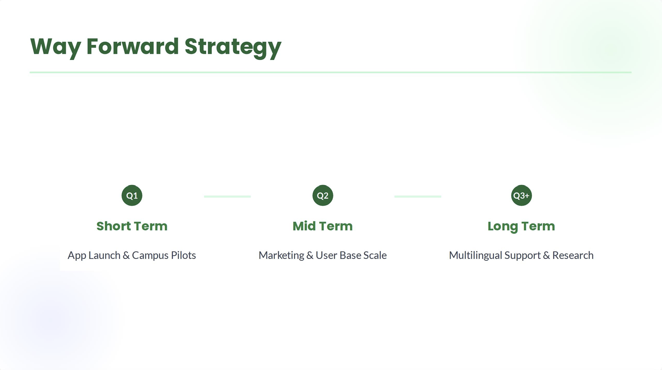
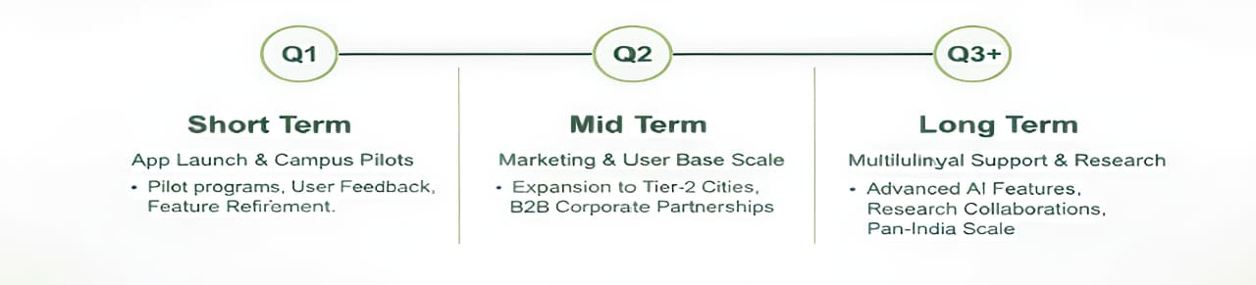
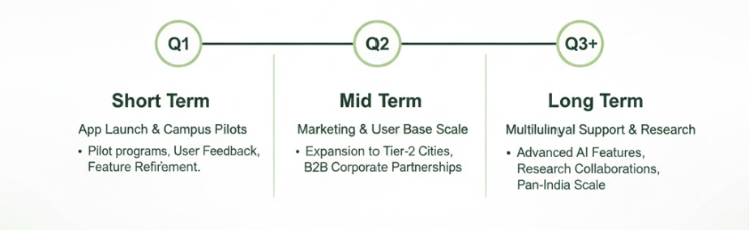
11. Way forward Strategy
What is your implementation strategy in short-term, midterm and long-term?
Finalize beta testing, join an incubation unit, and formally register the startup.
Launch the product across campuses, onboard early users and initiate institutional pilots. Begin exploring credit or seed funding options.
Secure angel or VC partnerships for equity based growth. Explore M&A or IPO pathways as the platform scales nationally.
LEARN NOW

Slide 13
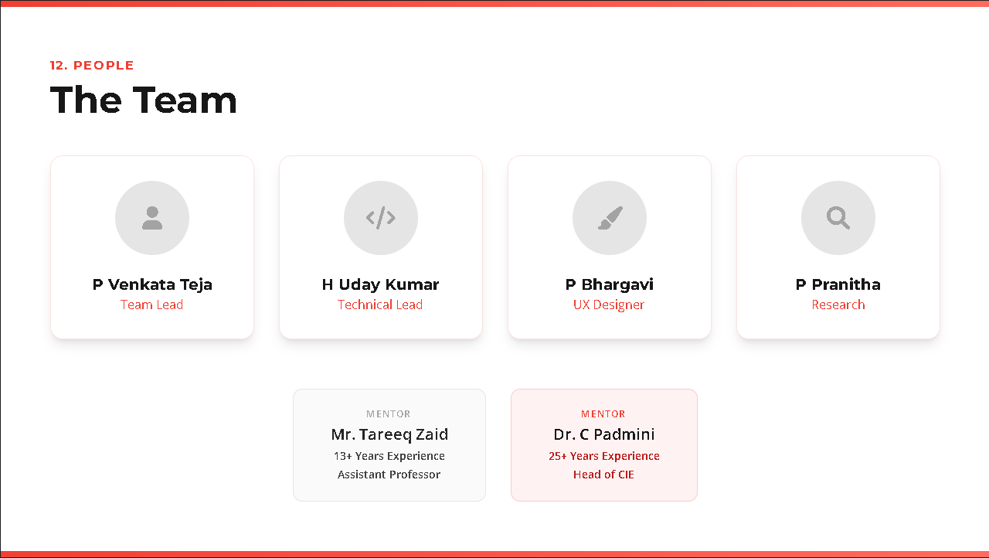
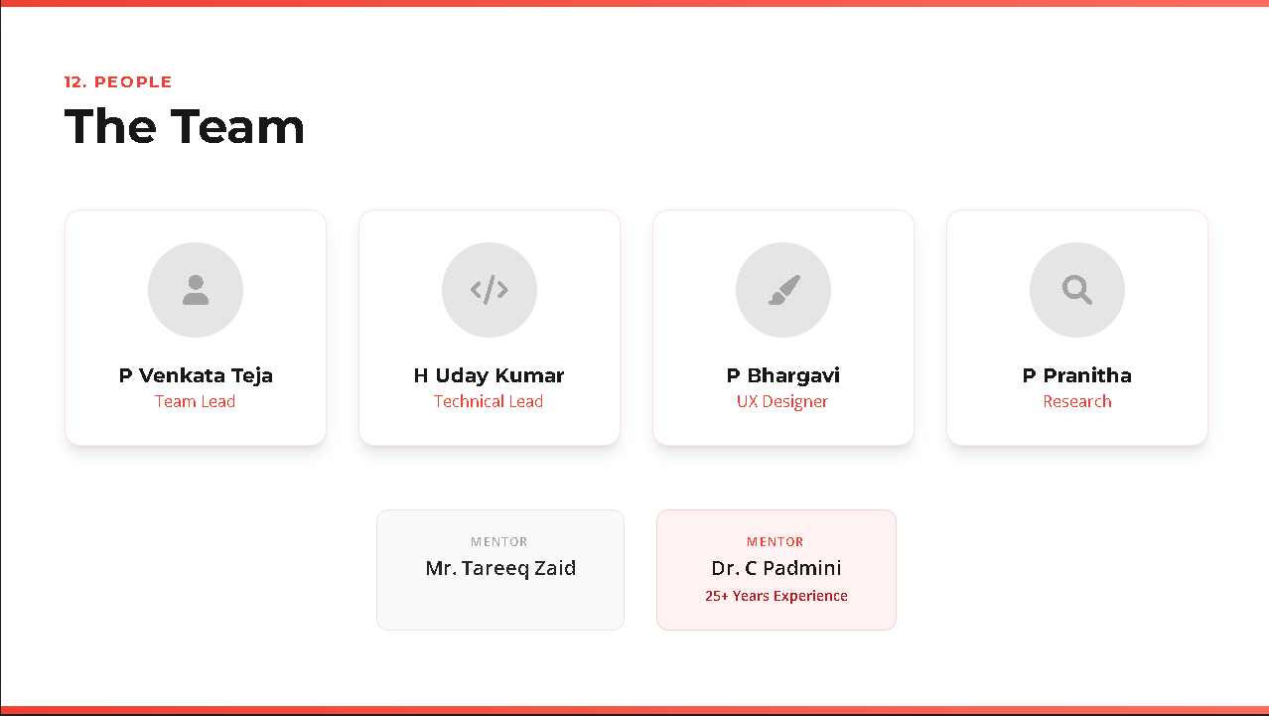
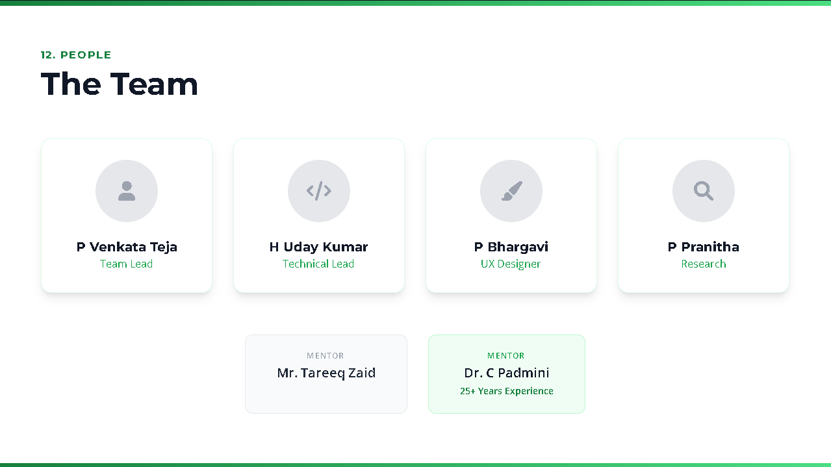
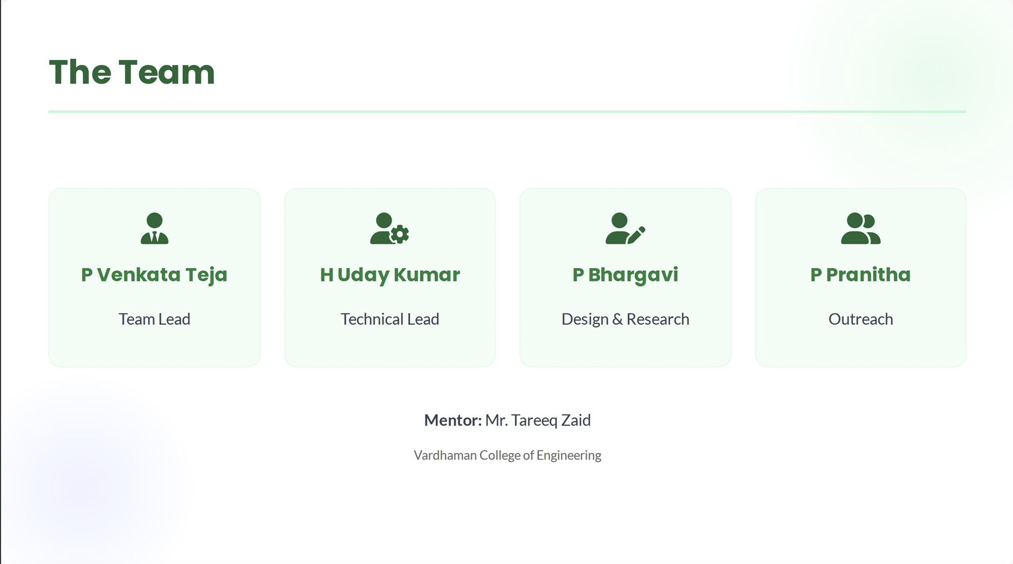
12. The Team
Show the people behind the idea and briefly describe their role
Venkata Teja – Team Lead, Uday Kumar – Tech Lead, managing full-stack dev. Bhargavi – Product support & testing. Pranitha – UX & desing refinement.
All team members are students, bringing fresh ideas, energy and a strong communication to building MindEase
The MindEase team is student-led, combining vision, tech, product and design skills. Venkata Teja drives strategy, Uday Kumar ensures strong tech builds, Bhargavi supports development and testing and Pranitha refines UX. Each brings fresh ideas and passion for mental hellness, united by the drive to build impactful startup solution.
LEARN NOW

Slide 14
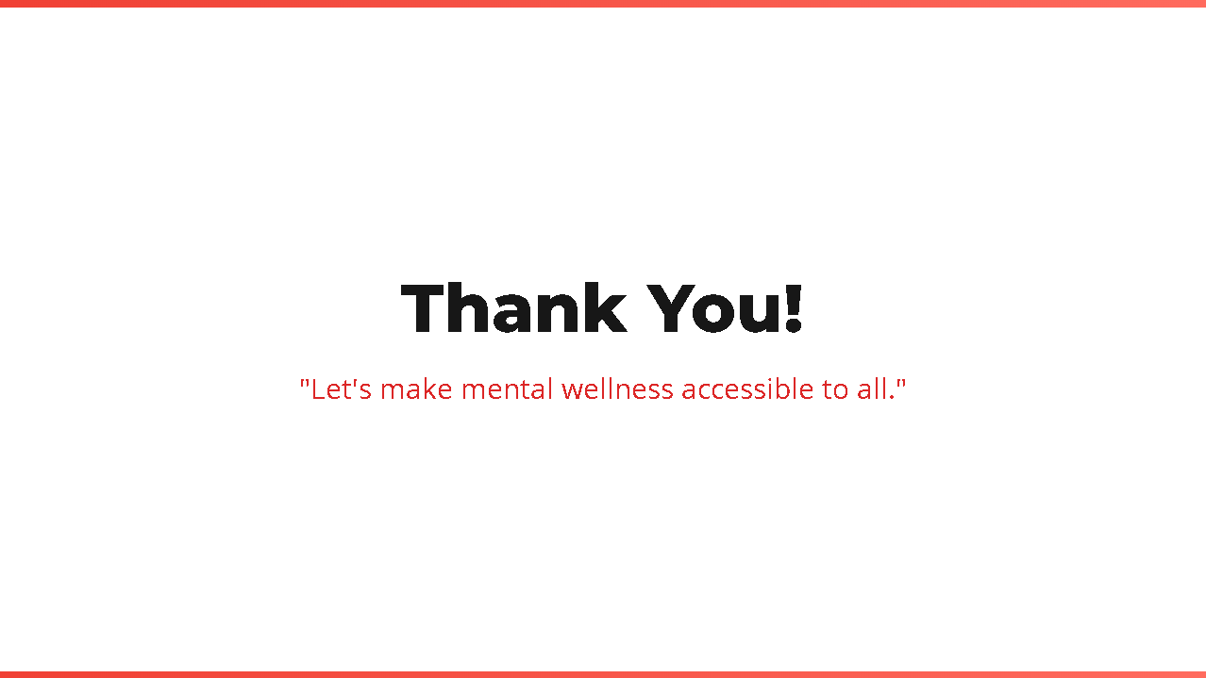
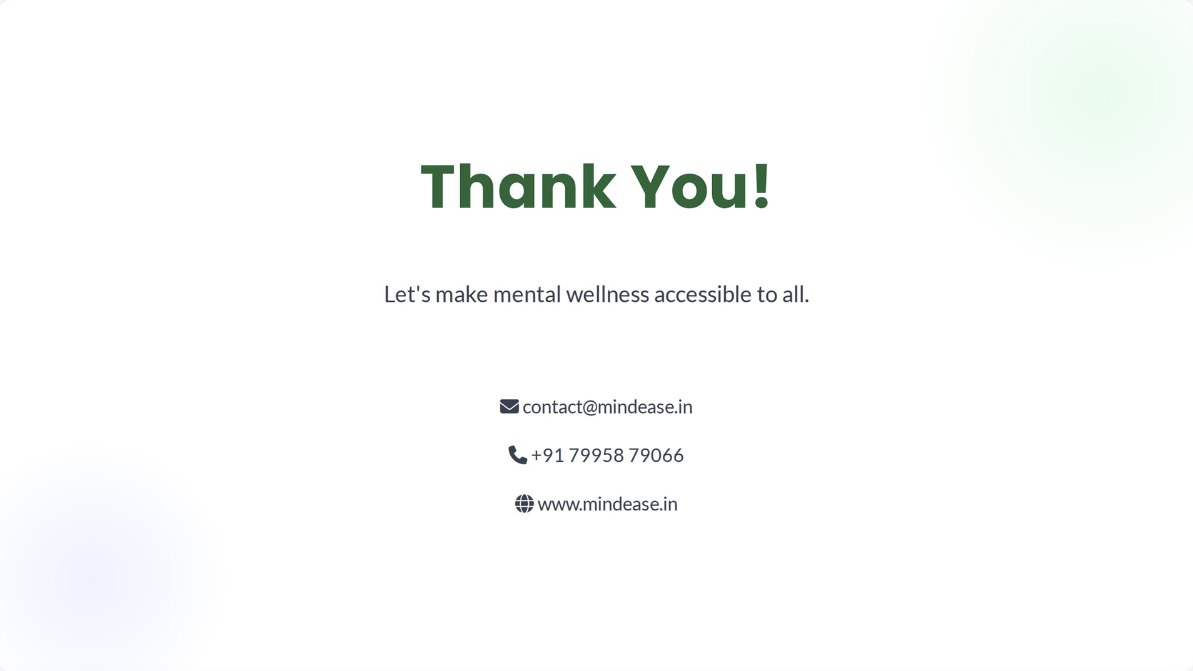
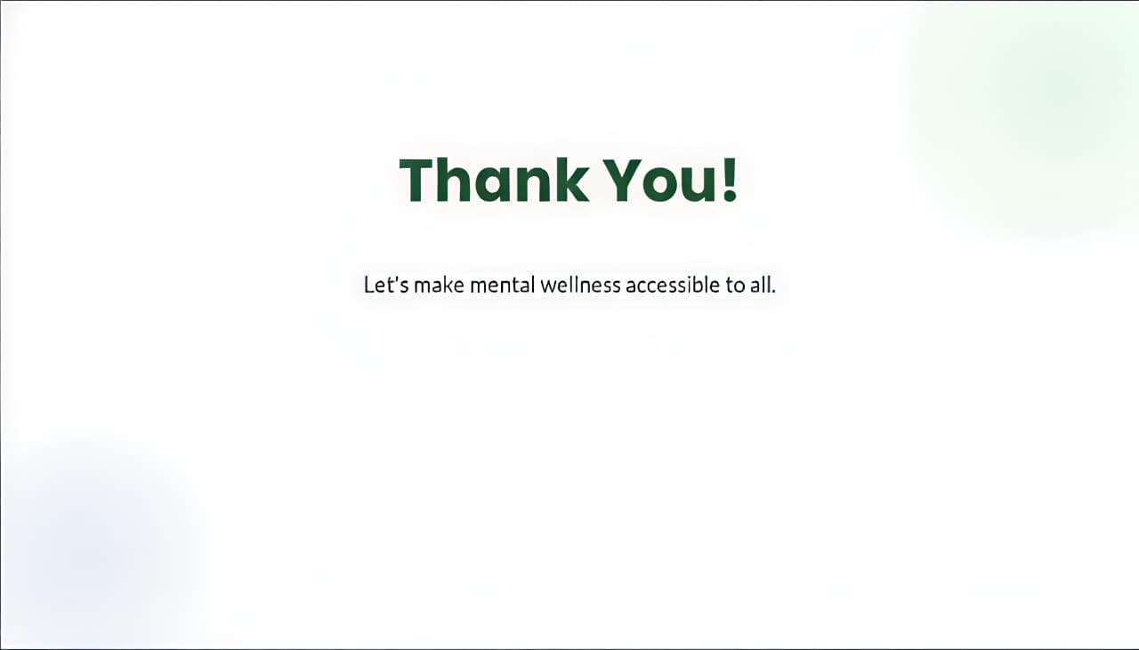
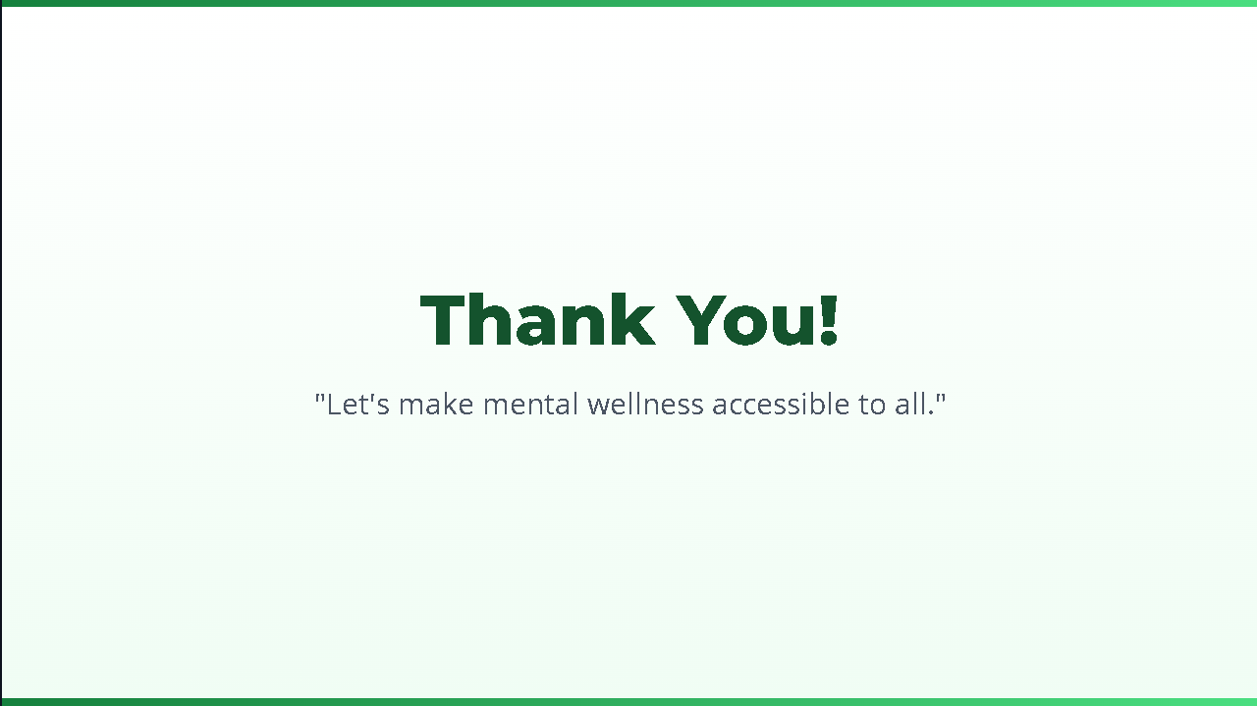
13. Contact
Leave your contact details and let people know how to reach you quickly
Venkata Teja(Team Lead)
Phone: +91 7995879066
Email: venkatatejapatnam@gmail.com
Uday Kumar(Tech Lead)
Phone: +91 7569311188
Email: udaykumarhaibathi@gmail.com
Bhargavi(Product Development)
Phone: 9059587902
Email: bhargavipunna5714@gmail.com
Pranitha(UX & Design)
Phone: +91 9493165041
Email: pranithapindi12@gmail.com
LEARN NOW

